Slide 1
The Colorado HOA Information & Resource Center
HOA Forum: May showers (also) brings June flowers” – Helpful Summer Maintenance Tips for HOA Living
Friday, May 30, 2025
Notes:
Good afternoon, everyone. Thank you for joining the May 2025 HOA Forum presented by the Colorado HOA Information & Resource Center. The topic of this month’s presentation is HOA Summer Maintenance Tips. My name is Nick Altmann, I am the HOA Information Officer for the office. I also have my colleagues Amanda Lopez and David Donnelly here with me today. A couple of house keeping items before we get started, today’s presentation will be recorded and uploaded to the Division’s YouTube channel. You can find the link to our channel at the end of this presentation, where you can view other videos about other HOA and Division topics.
To ensure we can answer your questions as efficiently and effectively as possible, the Q&A Feature is enabled for this presentation. If throughout the session you have questions, please click the Q&A icon at the bottom of your screen and we will do our best to answer your question at the end of the presentation. If we don’t get to your question, feel free to send us an email after. Our contact information is included at the end of the presentation. Lastly, the slides and a link to this video will be posted on our website within a couple days of this presentation.

Slide 2
Legal Disclaimer
The information in this presentation should not be construed as legal advice. It is intended for educational purposes only. If you have any legal questions, you should consult with a qualified, licensed attorney.

Slide 3
What the HOA Center does do:
•Provides information to homeowners regarding their basic rights and responsibilities under the Colorado Common Interest Ownership Act “CCIOA”
•Gathers, analyzes and reports information through complaints and HOA registrations
•Creates resource materials
•Provides educational material and forums
•Provides and maintains a website with information for the public
•Registers HOAs in accordance with §38-33.3-401(1) C.R.S.
•Provides an Annual Report to the Legislature

Slide 4
What the HOA Center does not do:
•Is not a regulatory program
•Does not mediate/arbitrate
•Cannot provide legal advice
•Does not act as an advocate
•Cannot assess fines or penalties
•Does not enforce an HOA’s failure to register

Slide 5
Talking Points
CCIOA Refresher
Sample Maintenance List
Landscaping
Dealing with nuisances
Flag Guidelines
Prepare Summer Amenities
Regular Pool Maintenance
AC/HVAC Maintenance
Playground/Picnic area
Pest: Work with Management or vendors to effectively schedule routine inspection
HOAs in Mountains

Slide 6
CCIOA - Maintenance Provision
Section 38-33.3-307, C.R.S. of the Colorado Common Interest Ownership Act (“CCIOA”) states that “Except to the extent provided by the declaration, subsection (2) of this section, or section 38-33.3-313(9), C.R.S., the association is responsible for maintenance, repair, and replacement of the common elements, and each unit owner is responsible for maintenance, repair, and replacement of such owner's unit.”

Slide 7
CCIOA - Unreasonable Restrictions and Prohibitions Prohibited
HOA’s have a responsibility to protect the unit owners’ ability to enjoy the common elements
During maintenance or repair of a common element, HOA may only restrict unit owners’ access to the common elements IF:
The restriction is needed to protect the safety of any individual; or
The restriction is needed to preserve the structural integrity or condition of a repair/modification.

Slide 8
CCIOA - Unreasonable Restrictions and Prohibitions Prohibited (con’t)
If the restriction or modification of the common element must last for longer than seventy-two (72) hours, the HOA MUST provide an electronic or written notice as soon as reasonably possible and includes:
A simple explanation or reason for the repair or modification; and,
An estimated duration of when the owners’ access to the common element will no longer be restricted; and,
A telephone number or email address where an owner may pose questions or concerns about the restriction for consideration by the HOA.
38-33.3-302.5, C.R.S.
Notes:
Statute does not specify whether the written notice must be first-class mail or certified mail, return receipt requested. Standard U.S. mail is permissible.

Slide 9
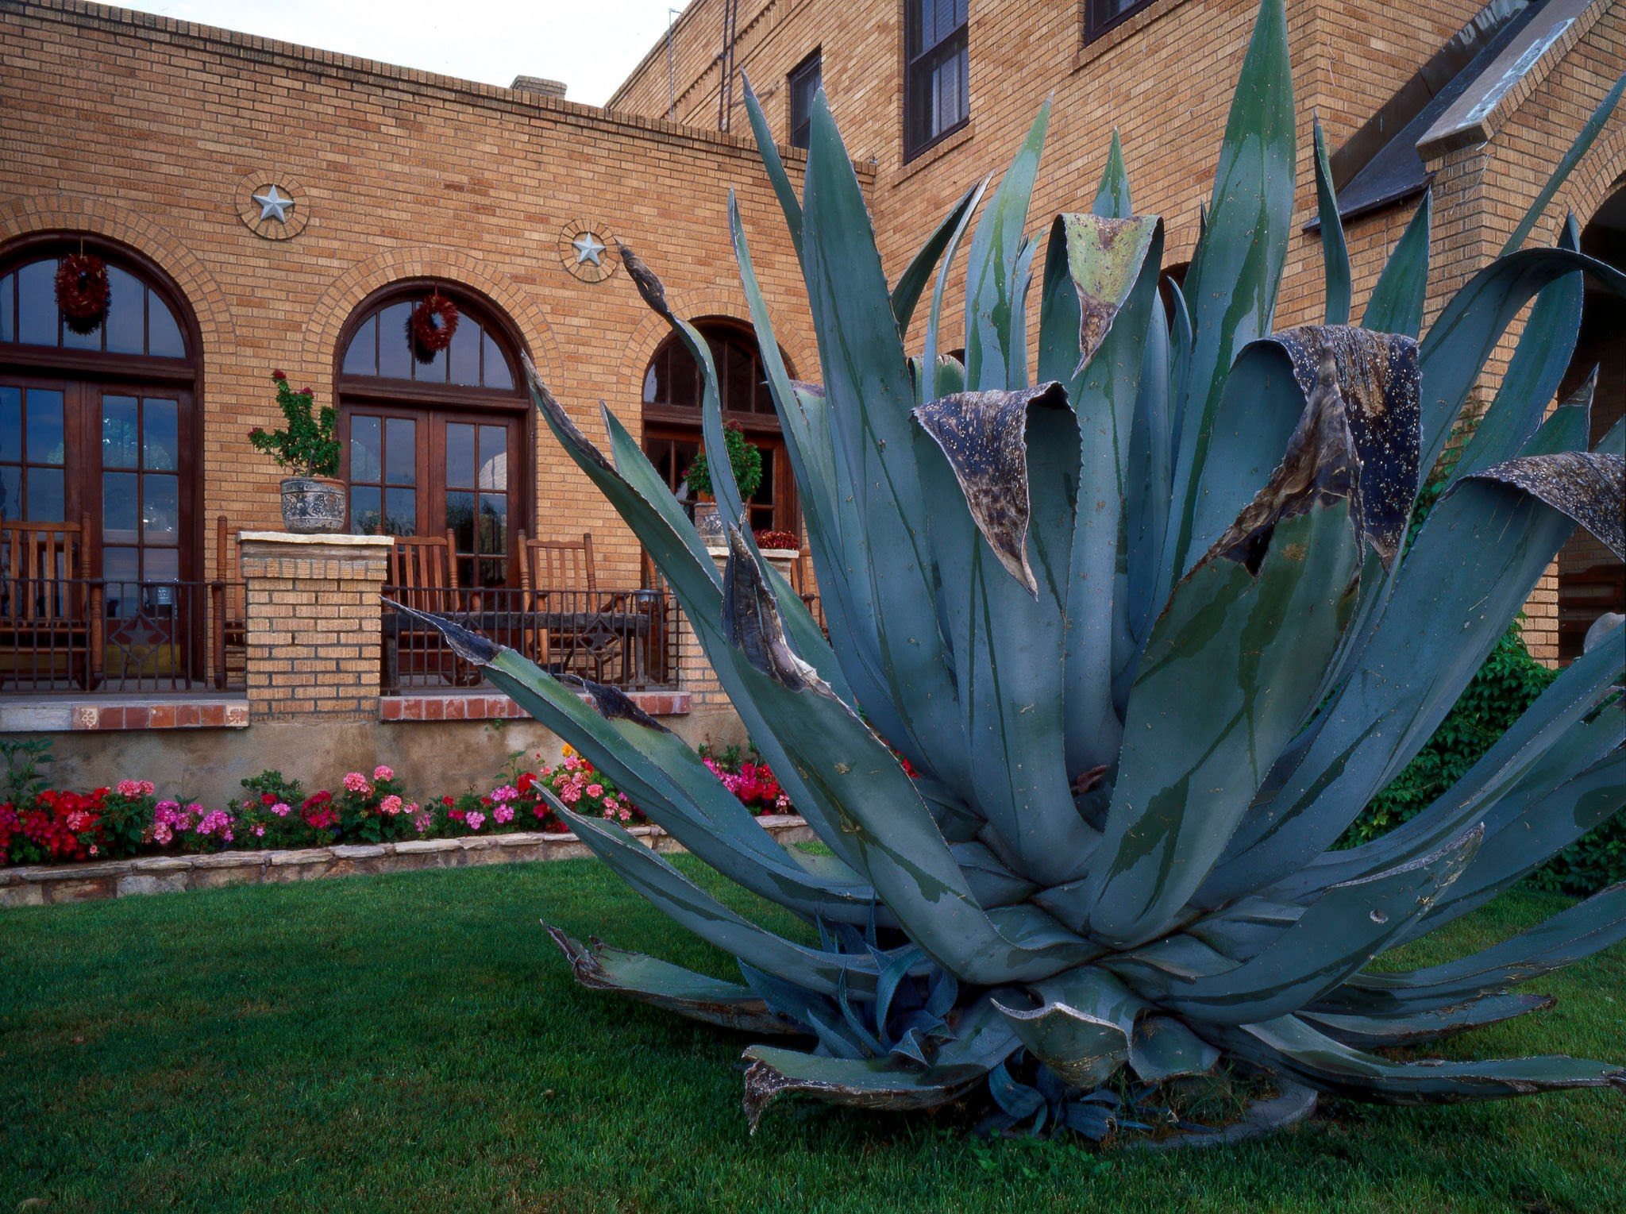
Pre-approved Waterwise Garden Designs
Water conservation!
HOAs must select three (3) garden designs that emphasize drought-tolerant and native plants for installation by unit owners’ in front yards from the Colorado State University’s (“CSU”) Plant Select website (or from another entity that makes these types of designs)
Useful website link: https://plantselect.org/ (select “HOA” tab)

Slide 10
Pre-approved Waterwise Garden Designs (con’t)
HOA must post the pre-approved garden designs on its public website (if any)
OWNERS DO NOT NEED TO OBTAIN ARCHITECTURAL REVIEW APPROVAL FIRST! As long as the owner has selected one of the HOAs pre-approved designs, the owners’ use of the design shall be considered to be in compliance with the HOAs aesthetic guidelines.
Civil remedies available to unit owners who are affected by an HOAs violation of this section
38-33.3-106.5(1)(i.5)(II), C.R.S.
Notes:
Purpose of this new law is to reduce barriers for owners’ to allow the owner to conserve water and save money. This includes for any right-of-way or tree lawn that an owner may be responsible for maintaining.

Slide 11
Summer Maintenance Checklist
Outdoor pest control
Sidewalks
Drainage
Foundation
Water faucets
Satellite dishes
Roofs
Gutters/Downspouts
Wood decks and patios
Pick up dog poop
Notes:
When starting to draft a maintenance plan, consider having a reserve study done. This will allow the Board to get an idea of what’s coming up as far as maintenance and repair is concerned, and what the financial status of the HOA is in regards to availability of funds for maintenance. Next, collect all maintenance related information such as maintenance requirements for keeping warranties valid; maintenance recommendations in owner manuals; expected costs and timeframes for replacing equipment or making major repairs to components, and; your association’s maintenance responsibility policy, which is typically found in your governing documents.
Gutters - Clear out any leaves and twigs accumulated over the Summer to ensure snowmelt can move freely away from the home in the Winter.

Slide 12
Summer Maintenance Checklist (con’t)
Roof interior inspection
Attic vents and screens
Flooring
Air conditioning units (condenser included)
Hot water heaters
Water lines
Yards/lawns
Landscaping/trimming
Fences
Gates
Security Cameras

Slide 13
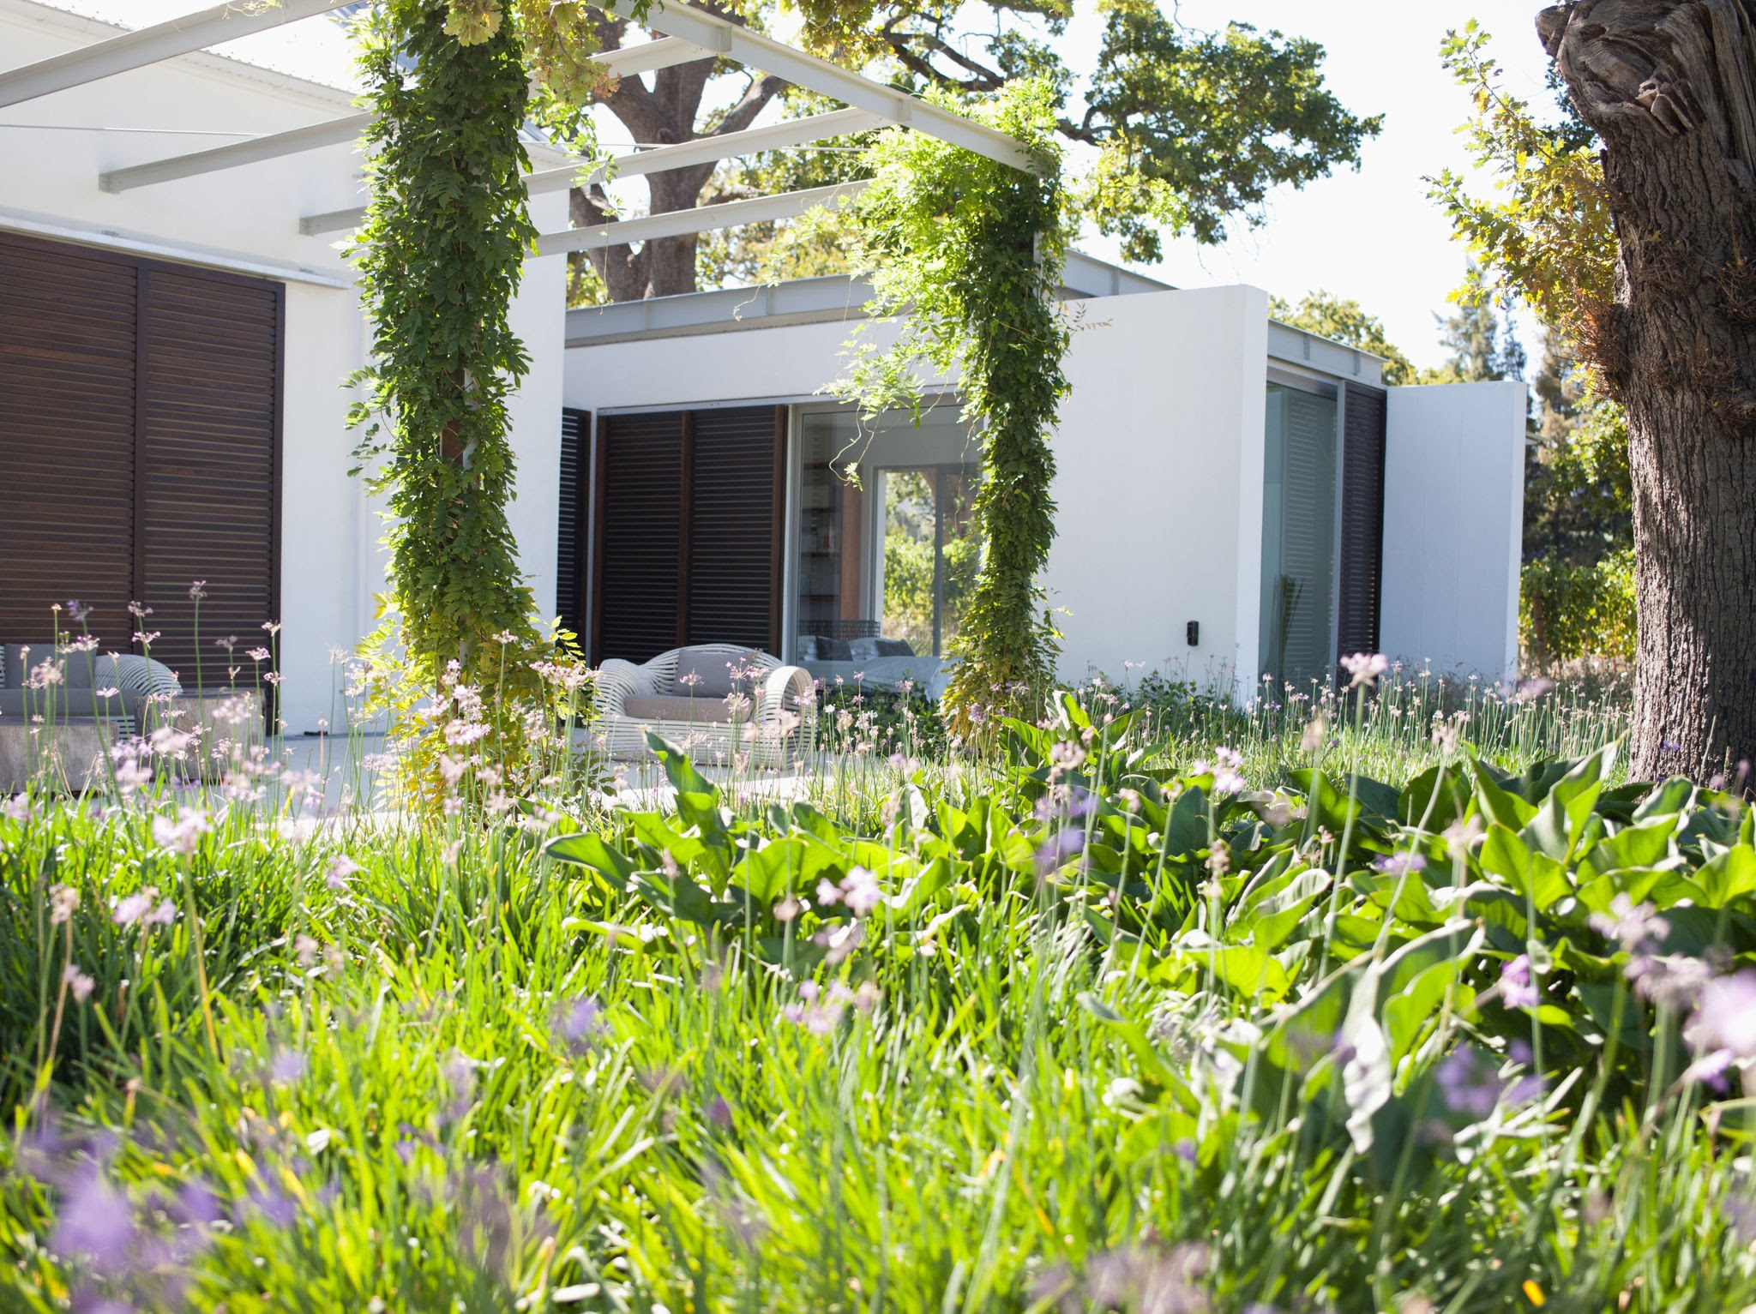
Landscaping
Lawns - ensure regular mowing, edging, and fertilization
Trees - trimming, remove dead or diseased plants, consult with an arborist
Garden - weeding, mulching
Irrigation - inspect for broken or leaking sprinkler heads, optimal coverage

Slide 14
Tips for Dealing with Nuisances
Defined by Colorado courts as “Unreasonable interference with the use and enjoyment of property”
Address the issue with the appropriate party
Law enforcement
Casual conversation with a neighbor
Formal complaint to the association
Courteous Correspondence will win the day!
Document any incident which lead to the nuisance
Check association policy on nuisances
Colorado Judicial Branch Office of Dispute Resolution

Slide 15
Nuisances – topics to consider
Type of neighborhood;
The nature of the wrong complained of;
Proximity of those alleging injury;
Frequency/duration;
Continuity;
Damage or degree of injury; and,
Number of complaining parties
Notes:
What may qualify as a nuisance?

Slide 16
Additional Tips
Create a regular maintenance schedule and stick to it
Keep receipts - dates, costs and names of contractors
Communicate well with owners
Consult with professionals
Consider conducting a reserve study

Slide 17
Flag Guidelines
Sections 38-33.3-106.5(1)(a) & (c) of the Colorado Common Interest Ownership Act (“CCIOA”) only allow associations to "adopt reasonable, content-neutral rules to regulate the number, location, and size of signs, flags and flagpoles
HOA may not "prohibit or regulate the display of window signs or yard signs on the basis of their subject matter, message, or content; except that the association may prohibit signs bearing commercial messages
Reasonableness" is a legal standard that ultimately requires legal expertise which the HOA Center is unable to provide

Slide 18
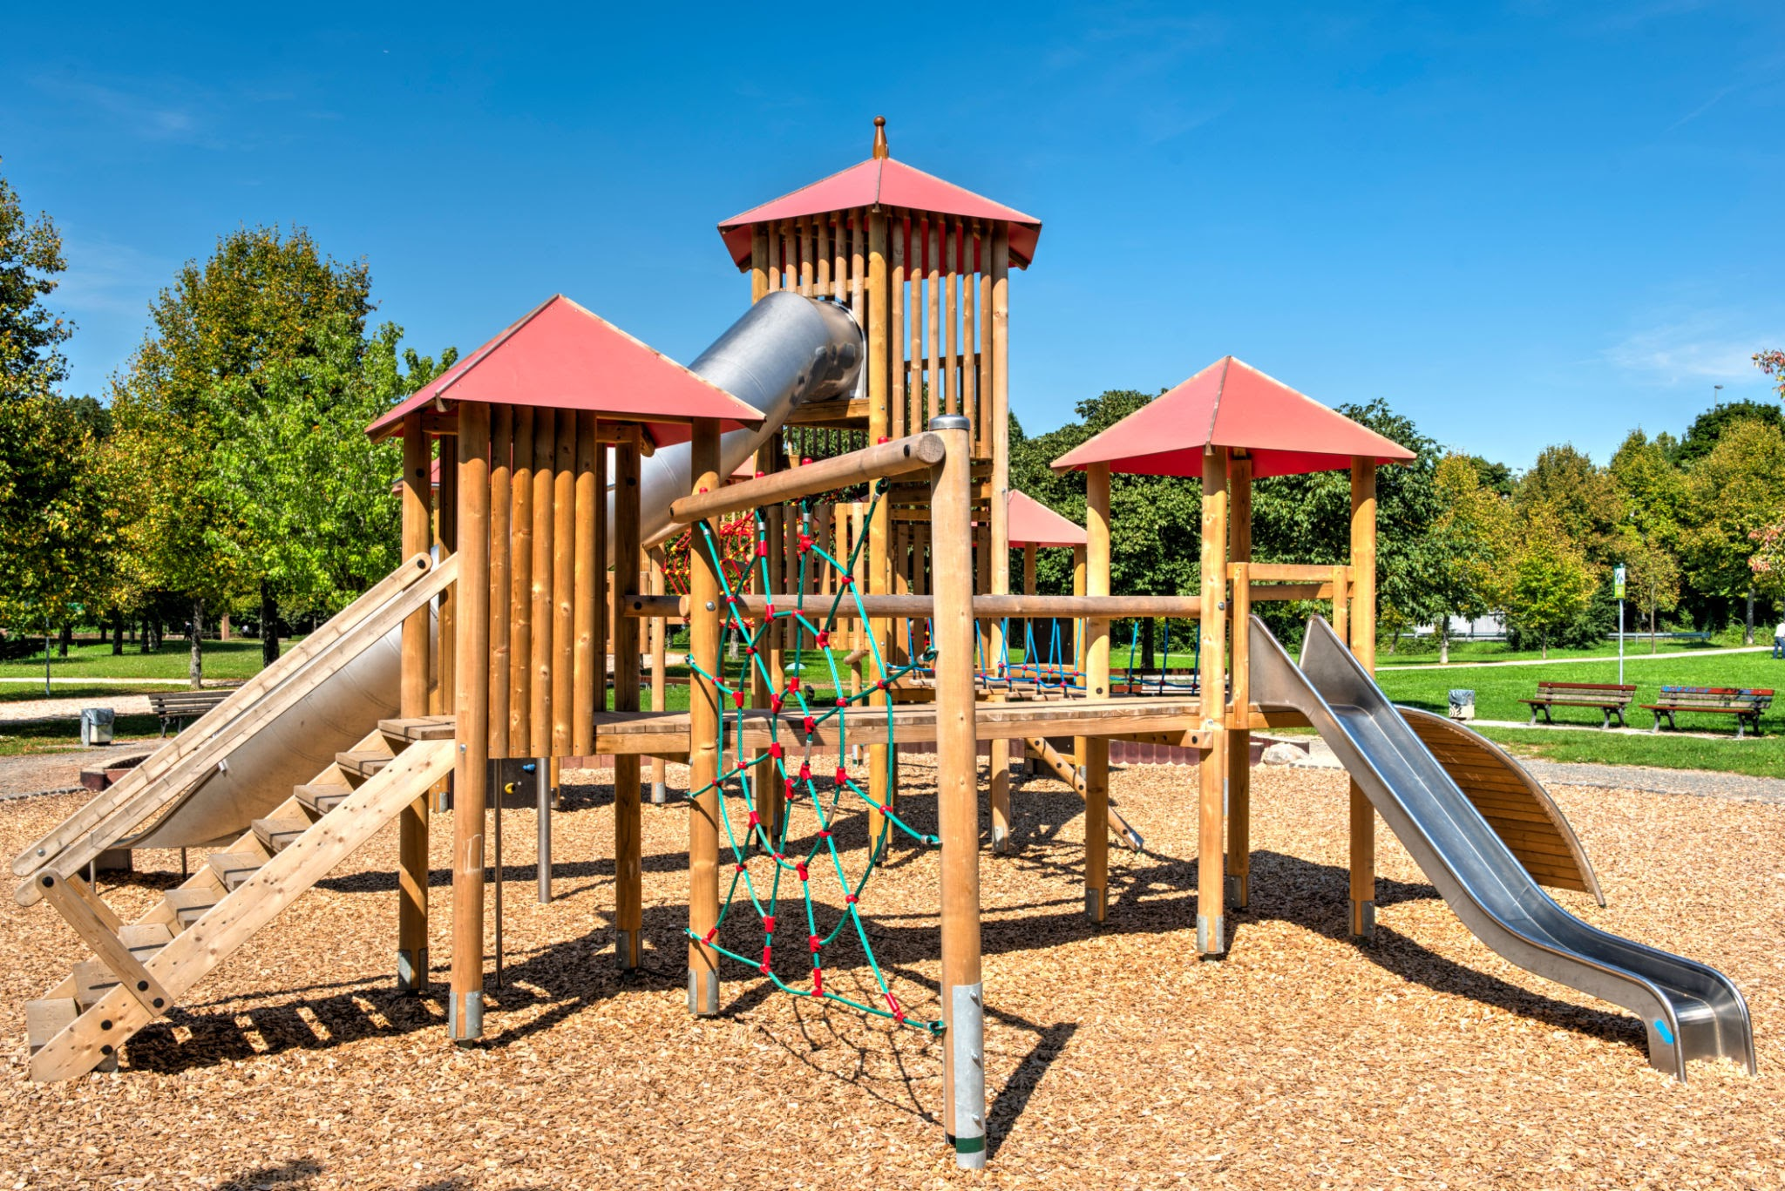
Prepare Summer Amenities
Playground and Recreational Area Upkeep
Examining playground equipment, sports courts, and picnic areas
Ensure playground equipment is safe for use and necessary repairs are completed

Slide 19
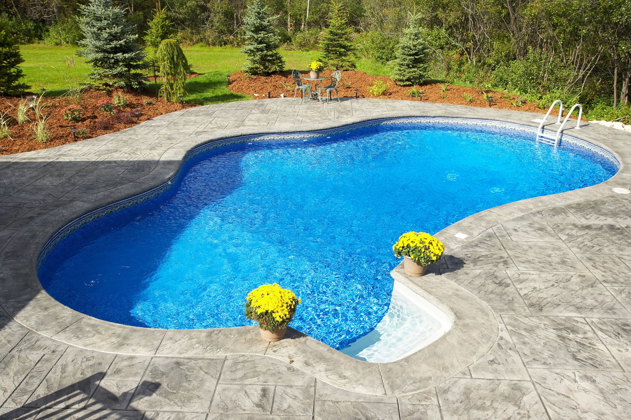
Pool Maintenance
Great way to beat the heat and stay cool on a hot day, but could also be any HOAs biggest but liability
Review Pool Maintenance and lifeguard service contracts, and ensure lifeguard training certificate is current and up to date
Working gates, lighting, lifeguard signage, depth of pool signs

Slide 20
Pool Maintenance (con’t)
Review Cleaning and Chemical Treatment Schedules, and required repairs
Ensure that pool insurance is up to date
Federal and State Fair Housing laws prohibit HOAs from discriminating against individuals based on their familial status

Slide 21
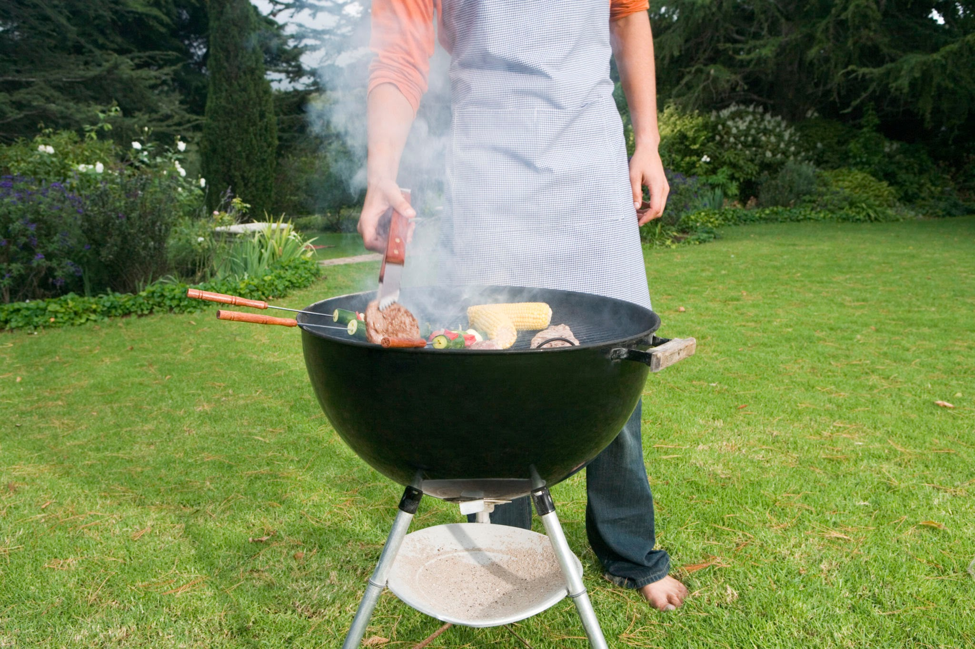
BBQ Grill Safety
HOAs and Homeowners have a legal obligation to adhere to city ordinances and International Fire Code (IFC)
According to The Denver Fire Department, the majority of grill fires on residential properties take place in the Summer months and almost half occur in the evening hours. Additionally, grill fires on residential properties start on patios, terraces, screened-in porches, or courtyards, while others start on exterior balconies and unenclosed porches

Slide 22
BBQ Grill Safety (con’t)
Contact the City and County in which the HOA is located for more information regarding the city fire codes.
Ensure fire related safety measures are followed and maintained

Slide 23
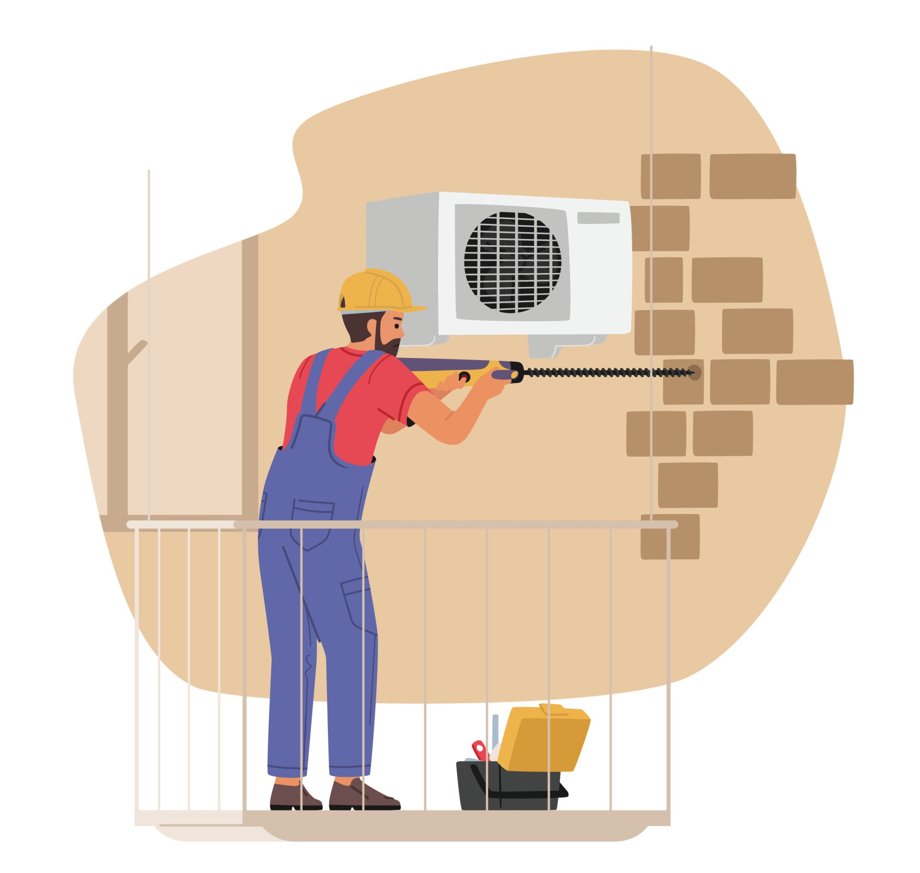
AC/HVAC Maintenance
AC/HVAC Scheduled preventative maintenance and repairs
HOA is responsible for maintaining common elements which may include a shared HVAC system that serves multiple units
Maintenance of HVAC in common shared areas such as clubhouses and fitness centers
Section 38-33.3-307, C.R.S. of CCIOA states HOA’s responsibility for maintenance, repair, and replacement of the common elements

Slide 24
Pests/Wildlife
Warmer weather can bring uninvited critters
Avoid pest infestations by hiring professionals to conduct inspections on a regular basis
squirrels, rats, raccoons, termites, and roaches.
More than just a nuisance, they can also pose serious health risks and can even damage the property

Slide 25
Pests/Wildlife (con’t)
Colorado is known for its wildlife which can also become a nuisance to some homeowners and danger to pets
Open spaces, parks, river bottoms and on or near bodies of water
Did you know that there are state laws and regulations for managing nuisance wildlife? Colorado Parks and Wildlife has specific restrictions and state regulations/statutes for managing nuisance wildlife
cpw.state.co.us/living-wildlife

Slide 26
Fireworks
May be prohibited in most HOAs
Illegal for sale and use in Colorado
Become familiar with both local ordinances and their HOA's rules before the use of any fireworks
Some HOAs may allow permissible fireworks (Sparklers, fountains, smoke balls )

Slide 27
Questions?

Slide 28
Contact Information

